Slide 1
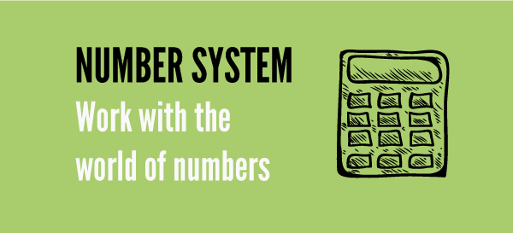
Number Systems

Slide 2

Content
TYPES OF NUMBERS
Conversion of a decimal number to fraction
DIVISIBILITY RULE
REMAINDER THEOREM
Power Cycle and Unit Digit Concept
FACTORS AND MULTIPLES
i) Number of factors
ii) Sum of factors
iii) Product of factors
HCF & LCM
AP & GP

Slide 3
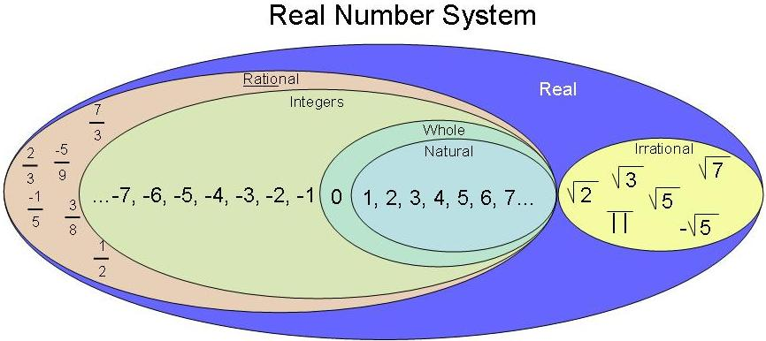


Types of numbers

Slide 4
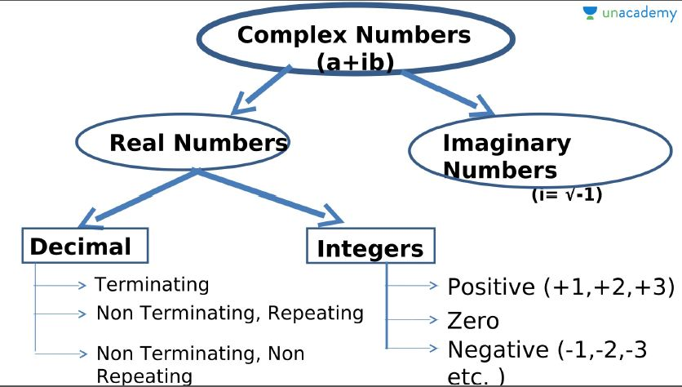







Slide 5
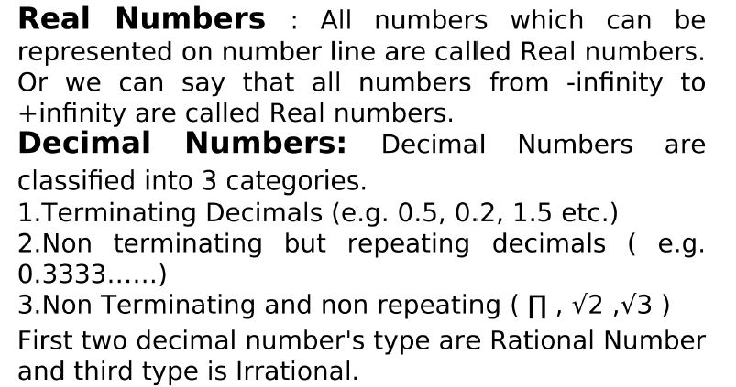

Slide 6
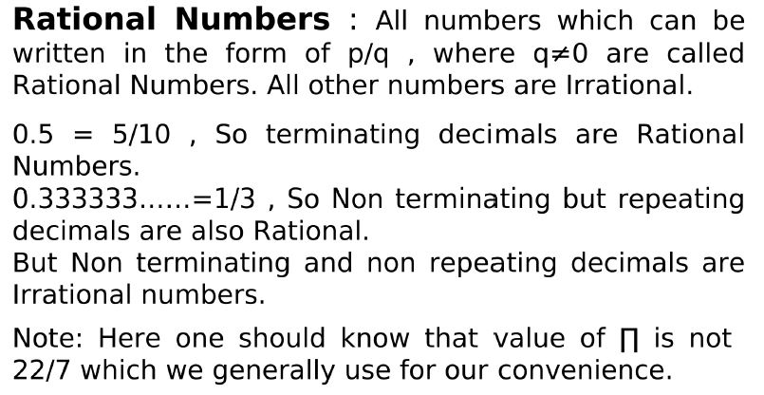

Slide 7
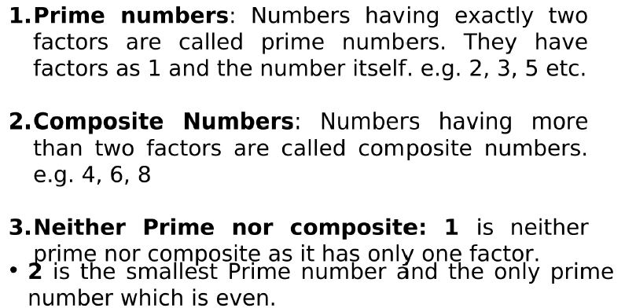
Positive Integers: Positive integers can be categories in many ways.

Slide 8
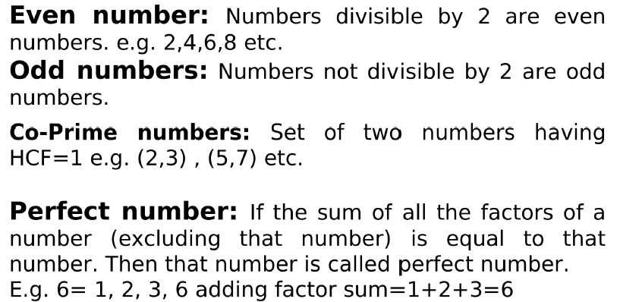

Slide 9
Important rules related to Even and Odd numbers:
odd ± odd = even;
even ± even = even;
even ± odd = odd
odd × odd = odd;
even × even = even;
even × odd = even.
odd^{(any number)} = odd
even^{(any number)} = even
How to find whether a no is Prime or not

Slide 10
How to find if a number is prime or not?
N is a prime number if it is not divisible by numbers lesser than √N.
Example: 191 is a prime number since it is not divisible by 2, 3, 5, 7, 11 and 13 [numbers less than √191 (≈14)].
Note: Prime numbers will always be in the form (6k±1) where k= 1, 2, 3....
But not all (6k±1) will be a prime number.
(6k±1)
prime numbers

Slide 11
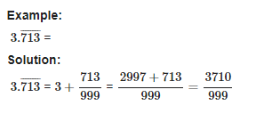
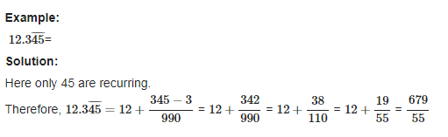
Conversion of a decimal number to fraction:

Slide 12
Q. Find the rational form of the recurring rational 0.2333333333
[A] 11/99
[B] 1/3
[C] 7/30
[D] 13/30
Let's represent the recurring decimal as "x":
x = 0.2333333333
Now, we multiply both sides of the equation by 10 to remove the repeating decimals:
10x = 2.3333333333
Next, we subtract the original equation from the multiplied equation to eliminate the repeating part:
10x - x = 2.3333333333 - 0.2333333333
Simplifying:
9x = 2.1
Dividing both sides by 9:
x = 2.1 / 9
Simplifying the fraction:
x = 7 / 30
Therefore, the rational form of the recurring decimal 0.2333333333 is 7/30.

Slide 13
Q. Convert 37.565656565656……………. into P/Q

Slide 14
Divisibility Rules
A number is divisible by 2
If the last digit is even.
3 If the sum of the digits is divisible by 3.
4 If the last two digits of the number divisible by 4.
5 If the last digit is a 5 or a 0.
6 If the number is divisible by both 3 and 2.
7 If the number formed by subtracting twice the last digit with the number formed by; rest of the digits is divisible by 7. Example: 343. 34-(3x2) = 28 is divisible by 7.
8 If the last three digits form a number divisible by 8.
9 If the sum of the digits is divisible by 9.
10 If the last digit of number is 0.
11If the difference between sum of digits in even places and the sum of the digits in odd places is 0 or divisible by 11.
Example: 365167484
(3+5+6+4+4) – (6+1+7+8) = 0 ∴ 365167484 is divisible by 11.
12 If the number is divisible by both 3 and 4.

Slide 15
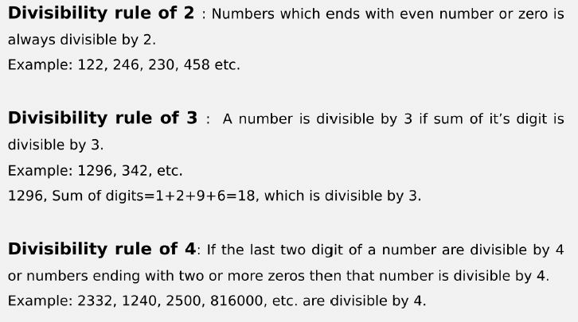
Divisibility Rules

Slide 16
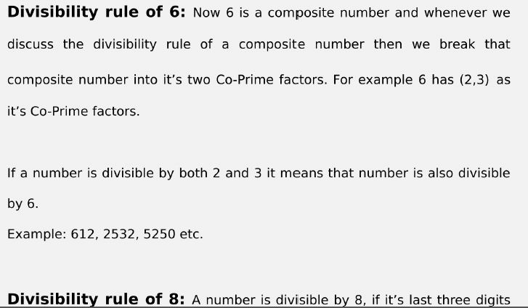

Slide 17
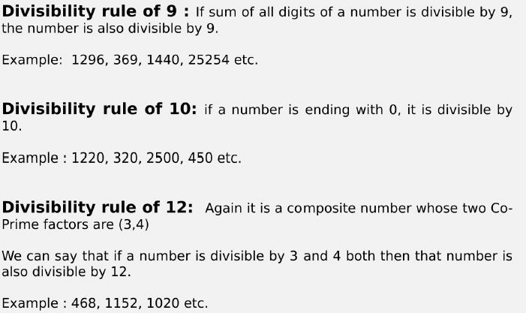

Slide 18
Any other numbers can be written in terms of the numbers whose divisibility is already known.
Example: 15 = 3 x 5
18 = 2 x 9
33 = 3 x 11
Note: The numbers expressed should be co-prime (i.e., the HCF of the two numbers should be 1)
Example: 40 = 4 x 10 is wrong because HCF(4,10) is 2.
∴ 40 = 5 x 8 because HCF(5,8) is 1.
How to find whether a no is Prime or not

Slide 19
Question: If number 1792N is divisible by 2. How many values N can take?
[A] 4
[B] 5
[C] 3
[D] 6

Slide 20
Question: What should come in place of K if 563K5 is divisible by 9?
[A] 7
[B] 8
[C] 9
[D] 2

Slide 21
Question: For what values of P number 345472P34 is exactly divisible by 9.
[A] 3
[B] 4
[C] 6
[D] 7

Slide 22
Question: For what values of N number 9724N is exactly divisible by 6.
[A] 2 & 8
[B] 4 & 6
[C] 2 & 6
[D] 6 & 8

Slide 23
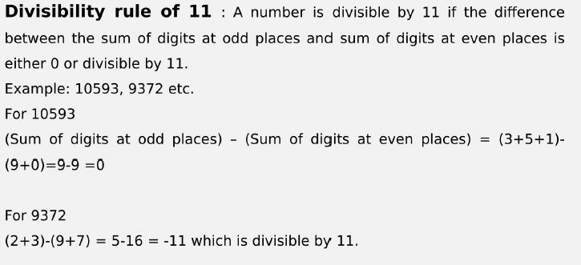

Slide 24
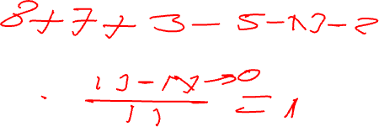
Question: For what values of N number 857N32 is exactly divisible by 11.
[A] 1
[B] 0
[C] 3
[D] 4

Slide 25
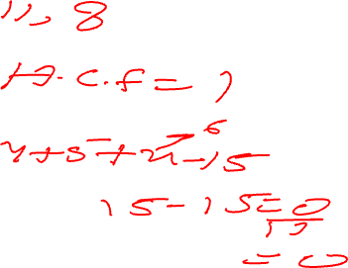
Question: What should come in place x if 4857x is divisible by 88?
[A] 6
[B] 8
[C] 2
[D] 4

Slide 26
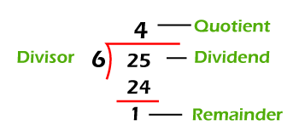
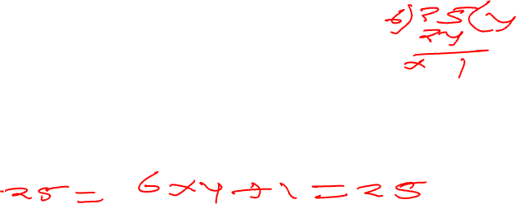
Remainder theorem
Dividend= (Divisor × Quotient + remainder)

Slide 27
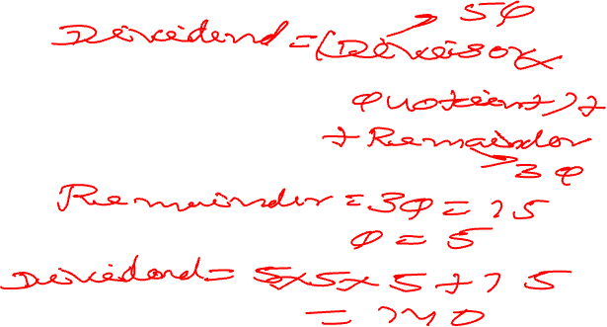
Question: In a division process divisor is 5 times of quotient and remainder is 3 times of quotient. If remainder is 15. Find dividend.
[A] 140
[B] 150
[C] 170
[D] 190

Slide 28
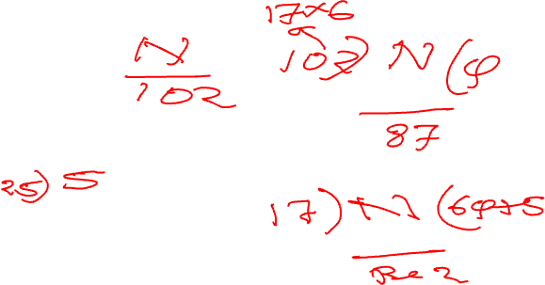
Question: When a number is divided by 102 leaves remainder 87. If the same no. is divided by 17. Find remainder.
[A] 1
[B] 5
[C] 7
[D] 2

Slide 29
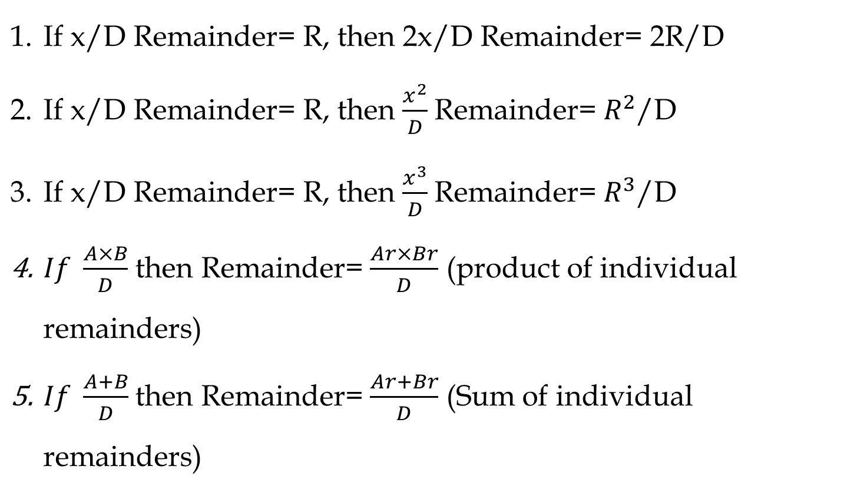
Important Rules

Slide 30
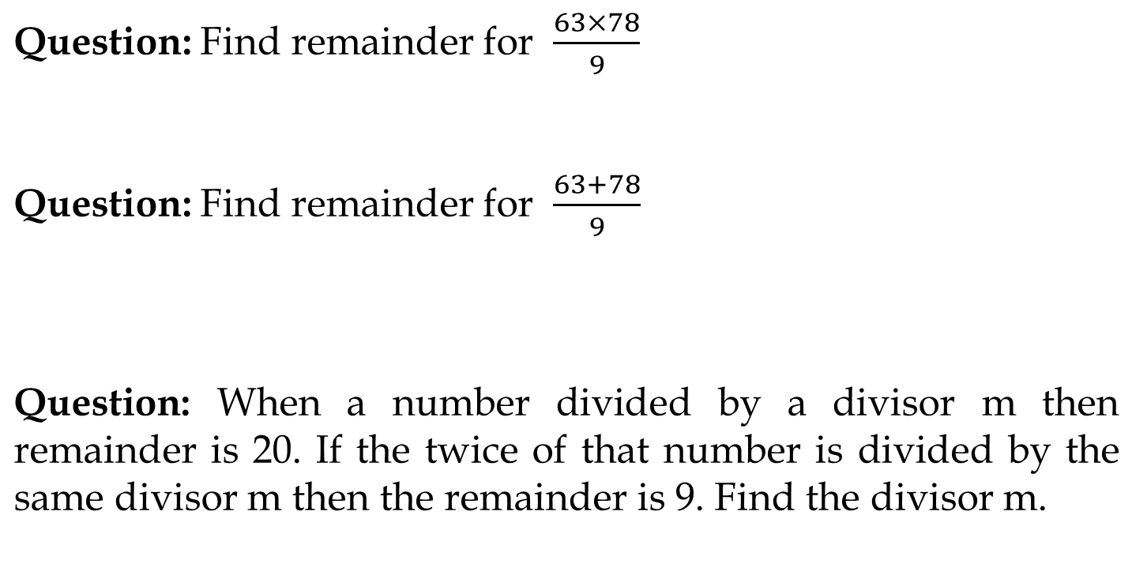

Slide 31
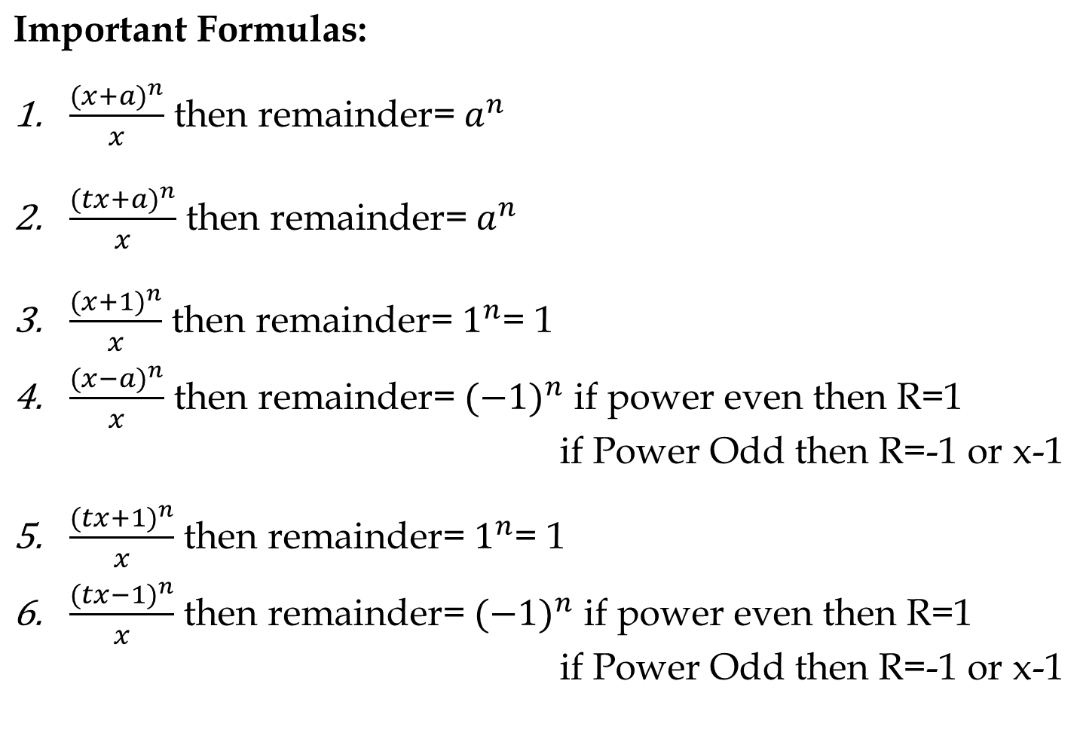

Slide 32
Remainder Cyclicity:
Example: What is the remainder when 2^202 is divided by 7?
2^1/7 = R(2)
2^2/7= R(4)
2^3/7 = R(1)
The next three remainder values will be the same. i.e., The remainder pattern is 2,4,1, 2,4,1, 2,4,1.....The size of the pattern is 3.
Now divide the power by number of repeating values (3) to choose the remainder.
Choose the nth value in the cycle if the remainder is n except for the last value whose remainder should be 0.
202/3 = R(1).
The 1st value in the cycle is 2.
Note: While finding the remainder pattern if the remainder becomes 1, then the process can be stopped as the it will always repeat after 1.
∴ 2^202/7 = R(2)

Slide 33
Note: Do not cancel any numerator value with the denominator value as the remainder will differ.
R(6/4) ≠ R(3/2)
6/4 = R(2)
But 3/2 = R(1)
If you want to cancel out numerator and denominator by a certain value then at last we also need to multiply the remainder by the same value in order to get correct remainder.

Slide 34
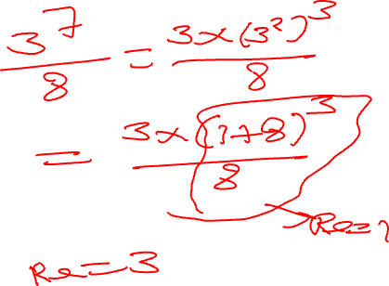
Q) What is the remainder when 3^7 is divided by 8?
[A] 3
[B] 4
[C] 5
[D] 7

Slide 35
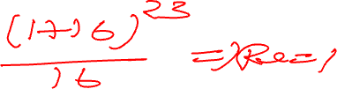
Q) Remainder when 17^23 is divided by 16?
[A] 1
[B] 2
[C] 3
[D] 4

Slide 36
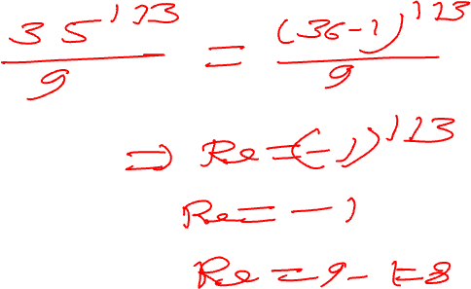
Q) Remainder when 35^113 is divided by 9?
[A] 1
[B] 8
[C] 3
[D] 4

Slide 37
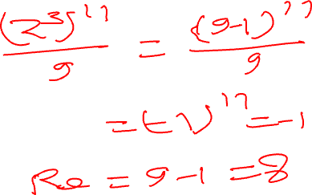
Q) Remainder when 2^33 is divided by 9?
[A] 1
[B] 4
[C] 8
[D] 5

Slide 38
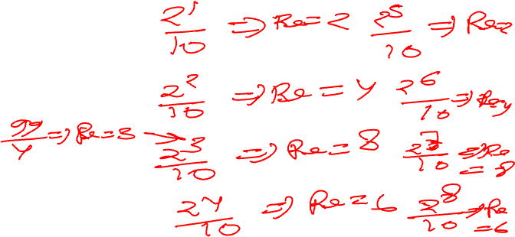
Q) Remainder when 2^99 is divided by 10?
[A] 1
[B] 4
[C] 2
[D] 8

Slide 39
Q) Remainder when 5^500 is divided by 500?
[A] 125
[B] 1
[C] 5
[D] 250
Ans. As

Slide 40
Unit Digit Concept
Right most digit of a number is called Unit digit.
For e.g. 278 × 623 what will be the unit digit?

Slide 41
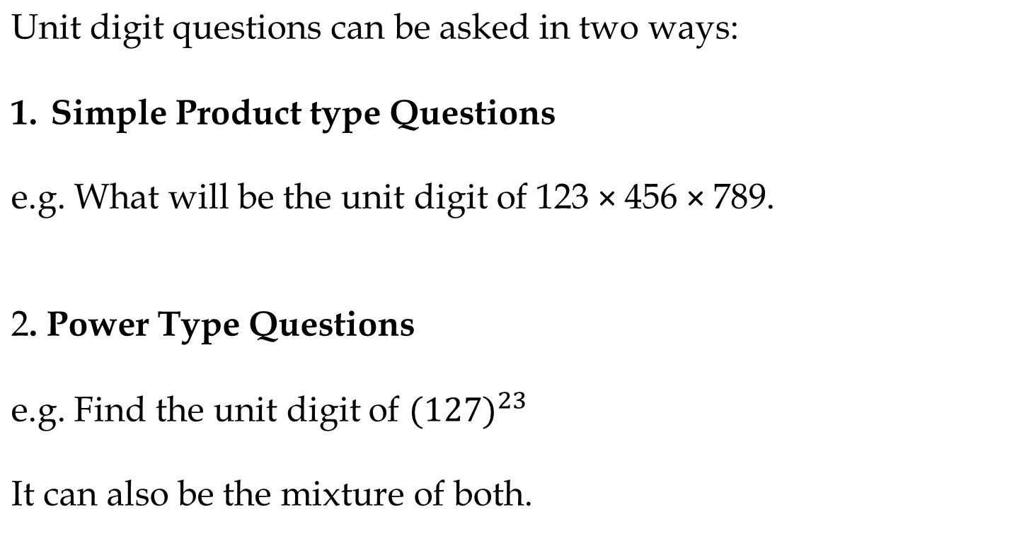

Slide 42
We can categories in three category:
Numbers ending with (0, 1, 5, 6)
Numbers ending with (4,9)
Numbers ending with (2,3,7,8)
Each category follow a certain rule.

Slide 43
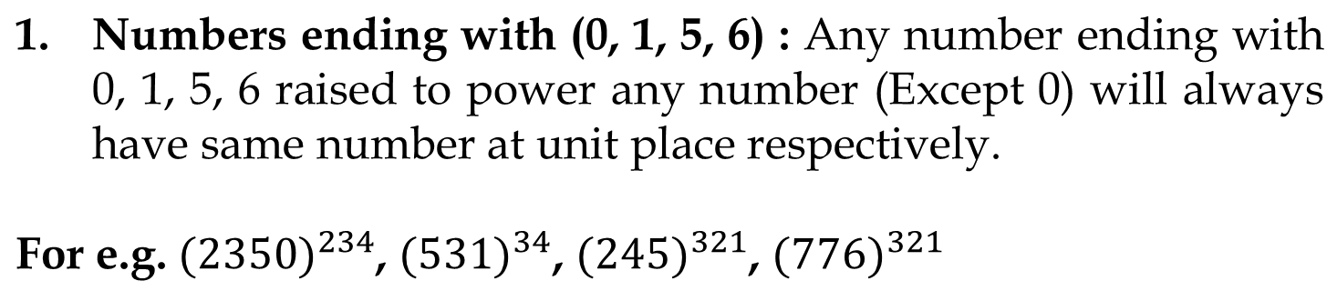

Slide 44
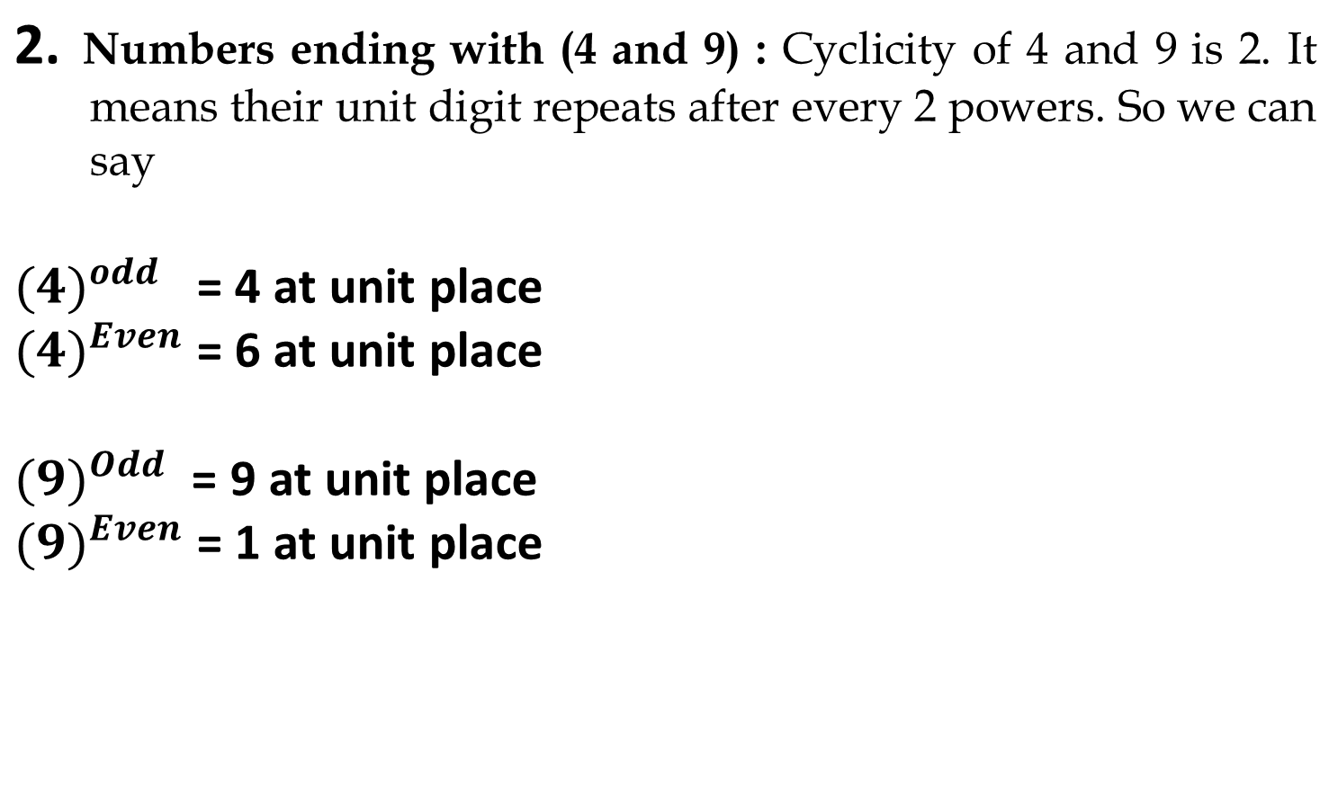

Slide 45
3. Numbers ending with (2,3,7,8) : All numbers have cyclicity of 4, it means after every 4th power the unit digit pattern will be same.
In these type of questions we will divide the power by cyclicity (i.e. 4) so that we will know how many cycles have been completed and we will try to find remainder. And unit digit will be (2,3,7,8)^Rem
Note: If remainder is zero then we take highest power of that cycle which is 4. or we can say (2,3,7,8)^4

Slide 46
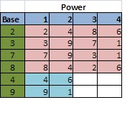
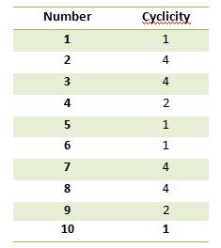
Choose the nth value in the cycle if the remainder is n except for the last value whose remainder should be 0.

Slide 47
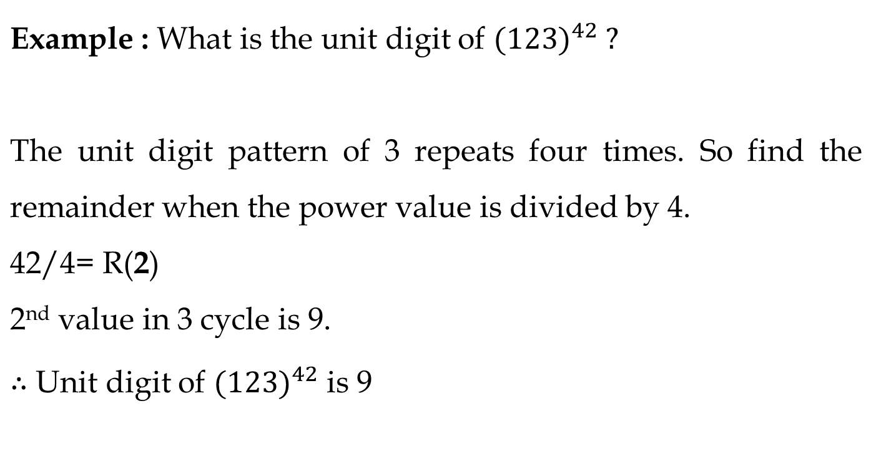
How to find whether a no is Prime or not

Slide 48
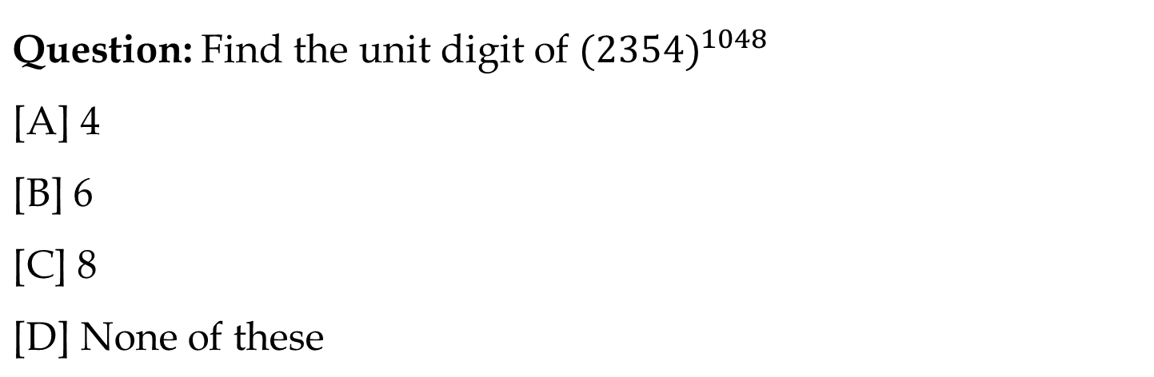
Ans. Bs

Slide 49
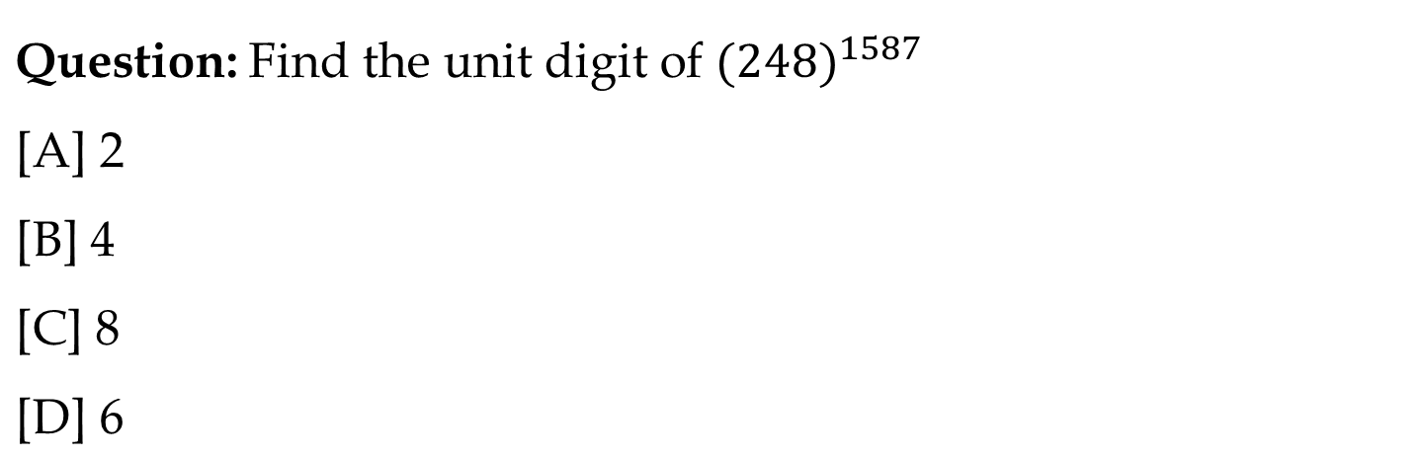
Ans. A

Slide 50
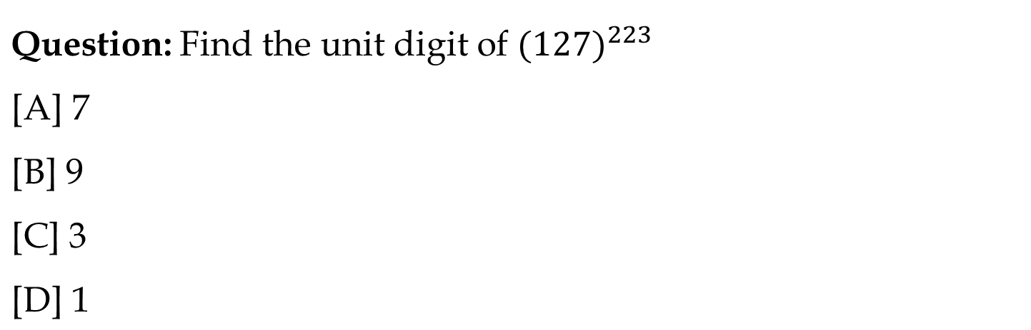
Ans. Cs

Slide 51
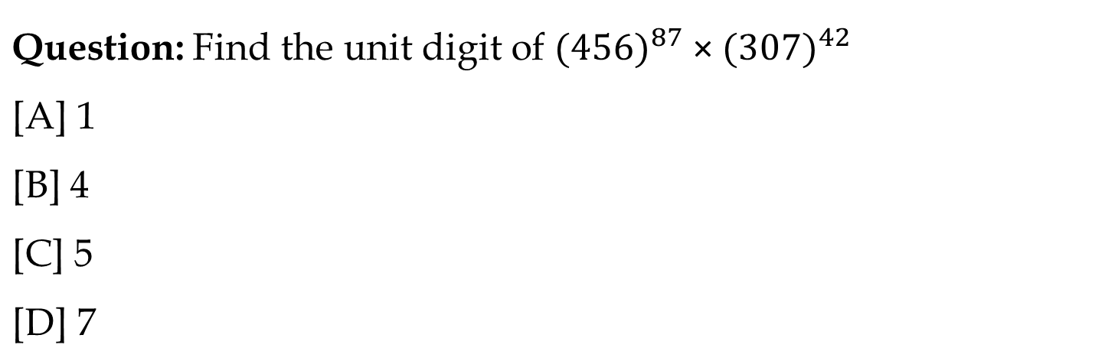
Ans. Bs

Slide 52
Factors
Factors of a number are the values that divides the number completely.
Example: Factors of 10 are 1, 2, 5 and 10.
Multiple of a number is the product of that number and any other whole number.
Example: multiples of 10 are 10, 20, 30,…..

Slide 53
Total number of factors
Sum of Factors
Product of Factors
Prime factors
Composite factors
Even factors
Odd factors
In how many ways a number can be written as a product of its two factors
In how many ways a number can be written as a product of its two co-prime factors

Slide 54
1. Total Number of factors:
Take any number “N” and it is to be covert into product of prime numbers (Prime factorization) i.e.
N = A^{p} x B^{q} x C^{r} here A, B , C are prime numbers and p, q, and r were respective powers of that prime numbers.
Total numbers of factors for N = (p + 1)(q +1)(r +1).

Slide 55
Example: 3600
Step 1: Prime factorize the given number
3600 = 36 x 100
= 6^2 x 10^2
= 2^2 x 3^2 x 2^2 x 5^2
= 2^4 x 3^2 x 5^2
Step 2: Add 1 to the powers and multiply.
(4+1) x (2+1) x (2+1)
= 5 x 3 x 3
= 45
∴ Number of factors of 3600 is 45.

Slide 56
Question: Find the total number of factors of 330.
[A] 2
[B] 8
[C] 16
[D] 32
Ans. Cs

Slide 57
Question: Find the total number of factors of 1560.
[A] 6
[B] 16
[C] 12
[D] 32
Ans. D

Slide 58
2. Sum of factors:
Example: 45
Step 1: Prime factorize the given number
45 = 3^2 x 5^1
Step 2: Split each prime factor as sum of every distinct factors.
(3^0 + 3^1 + 3^2) x (5^0 + 5^1)
The following result will be the sum of the factors
= 78

Slide 59
Question: Find the sum of factors of 24.
[A] 60
[B] 46
[C] 56
[D] 59
Ans. A

Slide 60
Question: Find the sum of factors of 98.
[A] 161
[B] 171
[C] 160
[D] None
Ans. Bs

Slide 61
3. Product of factors:
Product of factors of a number N is given by N^(Total factor/2)
Question: Find the product of factors of 24.

Slide 62
4. Prime factors:
Number of Prime factors used in prime factorization are prime factors.
5. Composite Factors:
(Total factors – Prime factors)-1

Slide 63
Question: Find the number of prime factors of 300.
[A] 2
[B] 3
[C] 4
[D] 5
Ans. Ds

Slide 64
Question: Find the number of composite factors of 42.
[A] 1
[B] 4
[C] 5
[D] 3
Ans. Bs

Slide 65
Even and Odd factors: We can find any one of two values and other we can find from subtracting from the total number of factors.
6. Odd factors: To find odd factors we will not consider power of 2 as it is a even Prime number.
Note: Do not consider even prime factor
7. Even factors: We can also find even factor directly. After prime factorization we will increase all power by 1 except power of 2. It will remain constant.

Slide 66
Odd Factors:
Example: 4500
4500 = 45 x 100 = 9 x 5 x 10 x 10 = 3 x 3 x 5 x 5 x 2 x 5 x 2
4500 = 2² x 3² x 5³ Here consider A = 2 , B = 3 , C = 5 , p= 2 , q = 2 and r = 3
Here identifying that odd number are 3 and 5
Numbers of odd factors of number 4500 = (q + 1 ) (r + 1) = 3 x 4 = 12
Note: Do not consider even prime factor

Slide 67
Question: How many factors of 340 are even.
[A] 12
[B] 16
[C] 8
[D] 6
Ans. Cs

Slide 68
Question: How many factors of 408 are even.
[A] 12
[B] 16
[C] 8
[D] 10
Ans. As

Slide 69
8. In how many ways a number can be written as a product of its two factors:
It is given by (Total Factors/2)
Note: If the total number of factors are odd then Product of two number= (total factors+1)/2

Slide 70
9. In how many ways a number can be written as a product of its two co-prime factors:
It is given by 2^(N – 1)
Where N= no. of prime factors of that number

Slide 71
Question: In How many ways 320 can be written as a product of its two co-prime factors .
[A] 2
[B] 6
[C] 1
[D] 5
Ans. As

Slide 72
Question: In How many ways 12 can be written as a product of its two co-prime factors .
[A] 2
[B] 6
[C] 8
[D] 6
Ans. As

Slide 73
Factors will occur in pairs for the numbers except perfect squares.
Example 1: A non perfect square number- 10
1 x 10 = 10
2 x 5 = 10
‘∴ Factors of 10 are 1, 2, 5 and 10.
Non perfect squares will have even number of factors

Slide 74
Example 2: A perfect square number- 16
1 x 16 = 16, 2 x 8 = 16, 4^2 = 16
∴ Factors of 16 are 1, 2, 4, 8 and 16.
Every perfect square will have odd number of factors because its square root number will pair with itself.
This has odd number of factors because 4 will pair with itself.
Every perfect square will have odd number of factors because its square root number will pair with itself.

Slide 75
Example 3: A prime square number- 49
The factors of 49 are 1, 7 and 49.
Prime square number will have exactly 3 factors (1, that number itself and square root of that number).
If N is a prime square number then the factors are 1, N and √N.

Slide 76
Trailing zeros (Number of zeros at the end)
Concept: In multiplication zero can be produced when we have a pair of 2 and 5. So, in order to find no. of zeros at the end, the pair of 2 and 5 need to be counted.
Example: 2^3 x 5 x 9 x 8 x 24 x 15 Find number of zeros at the end.

Slide 77
How to find Trailing zeros in any n! :
Ex: Find number of zeros in 10!
Answer: 10! = 1x2x3x4x5x6x7x8x9x10
Note: For any factorial value number of 5s are always less than number of 2s. So our concern will be to find number of 5.
For counting 5s in any n! value we divide n by powers of 5.
= [n/5] + [n/5^2] + [n/5^3] + [n/5^4]+…………

Slide 78
Question: Find number of trailing zeros in 100!
[A] 24
[B] 25
[C] 26
[D] 27

Slide 79
Question: Find number of trailing zeros in 154!
[A] 35
[B] 31
[C] 34
[D] 37

Slide 80
Question: Find number of trailing zeros in 56!
[A] 13
[B] 11
[C] 12
[D] 6

Slide 81
Question: Find number of trailing zero in 100!+200!
[A] 24
[B] 49
[C] 73
[D] None of these

Slide 82
Question: Find number of trailing zero in 100! X 200!
[A] 24
[B] 49
[C] 73
[D] None of these

Slide 83
LCM AND HCF
LCM- Least Common Multiple
LCM of given numbers X,Y,Z is the Least number which is exactly divisible by all the given numbers X,Y,Z.
OR we can say it is the least multiple of all the given numbers.
For e.g. 12= 12, 24, 36, 48, 60, 72, 84, 96…………
16= 16, 32, 48, 64, 80, 96…………
So there are lots of multiple of 12 and 16 which will be common but the least multiple which is common is 48. That is the LCM of 12 and 16.

Slide 84
FINDING L.C.M. OF BIG NUMBERS
Step 1 Find all the prime factors of both numbers.
Step 2 Multiply all the prime factors of the larger number by those prime factors of the smaller number that are not already included

Slide 85
HCF- Highest Common Factor
HCF of given numbers X,Y,Z is the greatest number which exactly divides all the given numbers X,Y,Z. Sometimes called Greatest Common divisor(G.C.D.)
For e.g. 12= 1, 2, 3, 4, 6, 12
16= 1, 2, 4, 8, 16
So there three common factor=1, 2, 4 but the Greatest factor is 4. That is the HCF of 12 and 16.

Slide 86
FINDING THE H.C.F. OF BIG NUMBERS
For larger numbers you can use the following method:
Step 1 Find all prime factors of both numbers.
Step 2 Write both numbers as a multiplication of prime numbers.
Step 3 Find which factors are repeating in both numbers and multiply them to get H.C.F

Slide 87
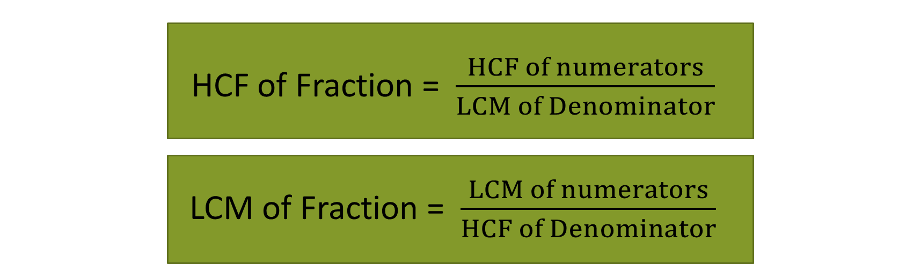
Important Formulae
Product of Two numbers = HCF × LCM

Slide 88
LCM Word Problems
Question | Answer
The Least number which is exactly divisible by x, y and z | LCM(x, y, z)
The least number which when divided by x, y, z leaves the same remainder R in each case | LCM (x, y, z) + R
The least Number which when divided by x, y and z, leaves remainder a, b and c respectively | LCM (x, y, z)-K Where K=(x-a)=(y-b)=(z-c)

Slide 89
HCF Word Problems
Question | Answer
The greatest number that will exactly divide x, y and z | HCF(x, y, z)
The greatest number that will divide x, y, z and leaves remainder R in each case | HCF(x-y, y-z, z-x) OR HCF(x-R, y-R, z-R)
The greatest Number that will divide x, y and z, leaving remainder a, b and c respectively | HCF(x-a, y-b, z-c)

Slide 90
Q) Find the lowest common multiple of 24, 36 and 40.
[A] 120
[B] 240
[C] 360
[D] 480

Slide 91
Q) The least number which is exactly divisible by 8, 16, 40 and 80 is:
[A] 16
[B] 120
[C] 80
[D] None

Slide 92
Q) The greatest number that will exactly divide 36 and 84 is:
[A] 4
[B] 6
[C] 12
[D] 18

Slide 93
Q) The greatest possible length which can be used to measure exactly the lengths 7 m, 3 m 85 cm, 12 m 95 cm is:
[A] 15
[B] 25
[C] 35
[D] 42

Slide 94
Q) Four bells ring at an interval 3min, 4min, 5min and 6 minutes respectively. If all the four bells ring at 9am first, when will it ring again?

Slide 95
Q) The H.C.F. of two numbers is 11 and their L.C.M. is 7700. If one of the numbers is 275, then the other is:
[A] 308
[B] 310
[C] 312
[D] None

Slide 96
Q) The H.C.F of 9/10, 12/25, 18/35, and 21/40 is?
[A] 3/1400
[B] 5/1400
[C] 7/1400
[D] None

Slide 97
Q) Which of the following fraction is the largest? 7/8, 13/16, 31/40, 63/80
[A] 7/8
[B] 13/16
[C] 31/40
[D] 63/80

Slide 98
Q) Three number are in the ratio of 3 : 4 : 5 and their L.C.M. is 2400. Their H.C.F. is:
[A] 40
[B] 80
[C] 120
[D] 200

Slide 99
Q) The ratio of two numbers is 3 : 4 and their H.C.F. is 4. Their L.C.M. is:
[A] 12
[B] 16
[C] 24
[D] 48

Slide 100
Q) The least number, which when divided by 12, 15, 20 and 54 leaves in each case a remainder of 8 is:
[A] 504
[B] 536
[C] 544
[D] 548

Slide 101
Q) Find the smallest number, which when divided by 3, 4 and 5 leaves remainder 1, 2 and 3 respectively?
[A] 60
[B] 53
[C] 58
[D] None

Slide 102
Q) The greatest number which on dividing 1657 and 2037 leaves remainders 6 and 5 respectively, is:
[A] 123
[B] 127
[C] 235
[D] 305

Slide 103
Q) Find the greatest number that will divide 43, 91 and 183 so as to leave the same remainder in each case.
[A] 4
[B] 7
[C] 9
[D] 13

Slide 104
Q) The product of two numbers is 4107. If the H.C.F. of these numbers is 37, then the greater number is:
[A] 101
[B] 107
[C] 111
[D] 185

